Slide 1

Sky High Tech
Code Fest-2023
Coding Contest
(junior)

Slide 2
Sky High Tech
Code Fest-2023
Coding Contest
(junior)
A/Mihinthale
National Collage

Slide 3
Sky High Tech
Code Fest-2023
Coding Contest
(junior)
A/Mihinthale
National Collage
About Our Teacher
Number
Name
NIC
A.N.S.
Gunarathna
838542042V
070 273 6237

Slide 4
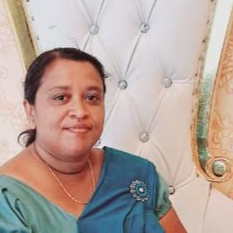
About Our Teacher
Name
NIC
Number
A.N.S.
Gunarathna
838542042V
070 273 6237

Slide 5
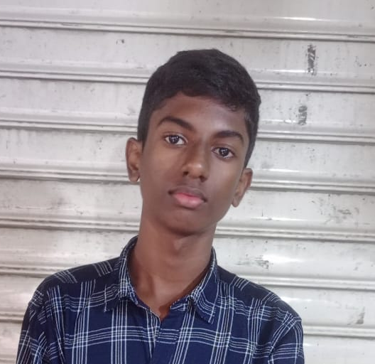
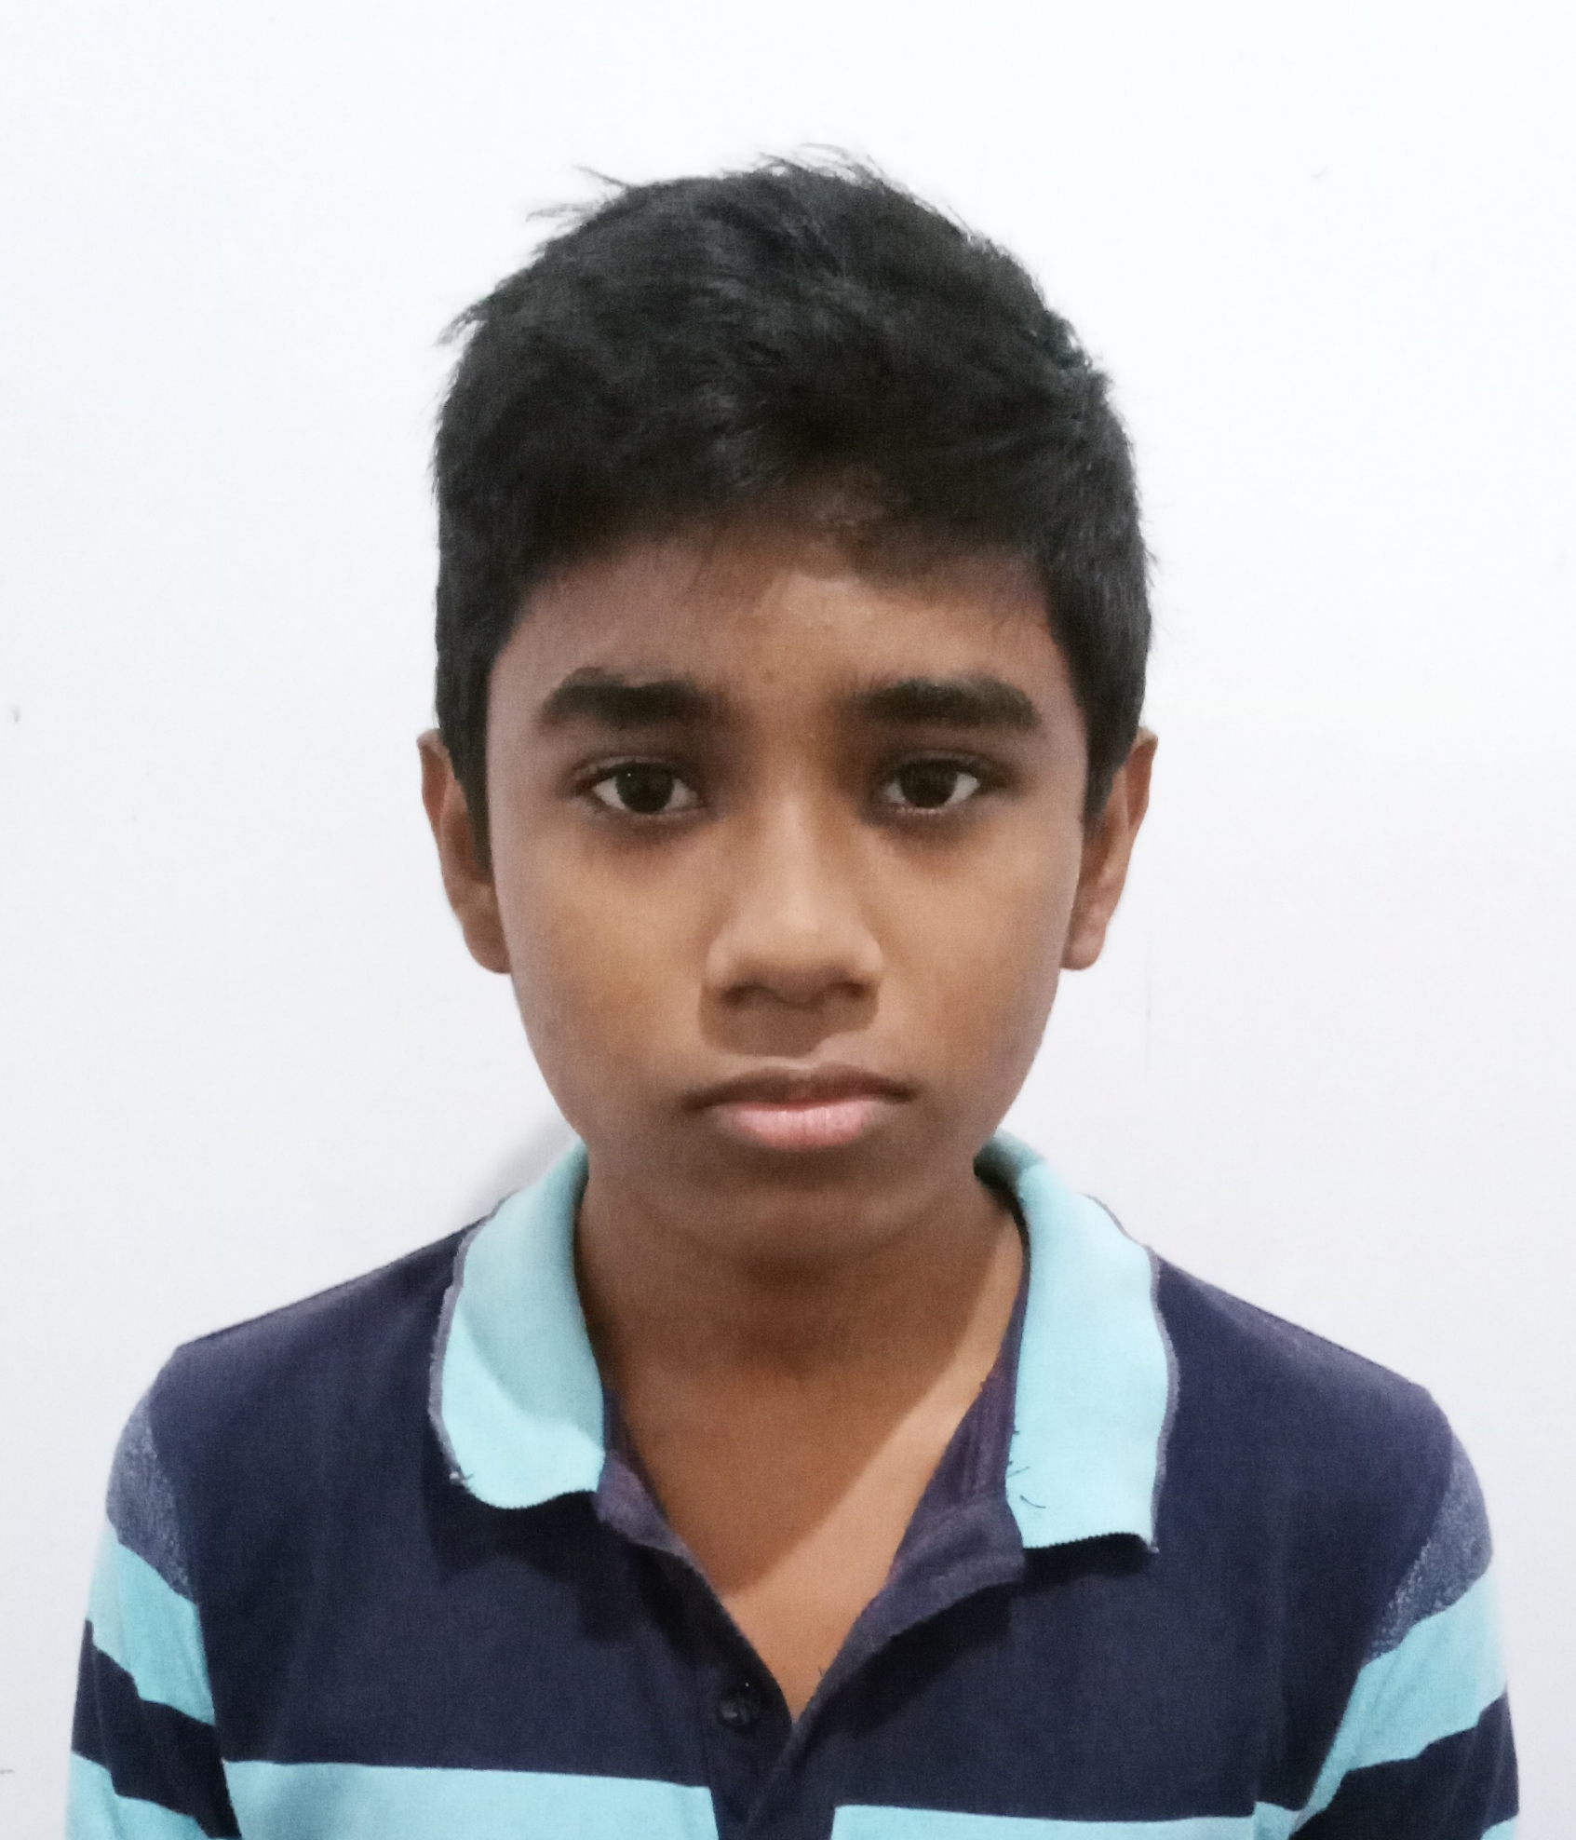
About Our Teacher
Name
NIC
Number
070 273 6237
A.N.S.
Gunarathna
838542042V
070 273 6237
C.R.M. Achintha Udana
Rajakaruna (Host)
Jenith Keerthi Oshadha

Slide 6
070 273 6237
C.R.M. Achintha Udana
Rajakaruna
Jenith Keerthi Oshadha
Nimsara
Shanaka

Slide 7
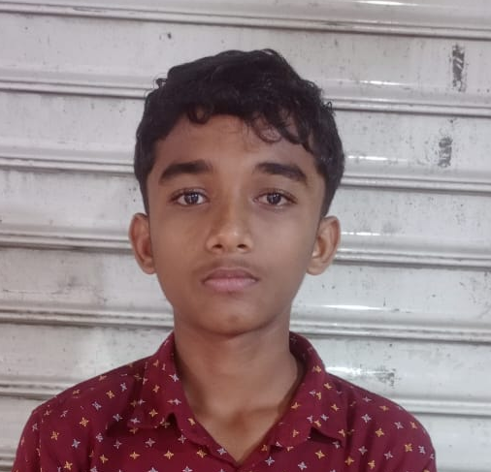
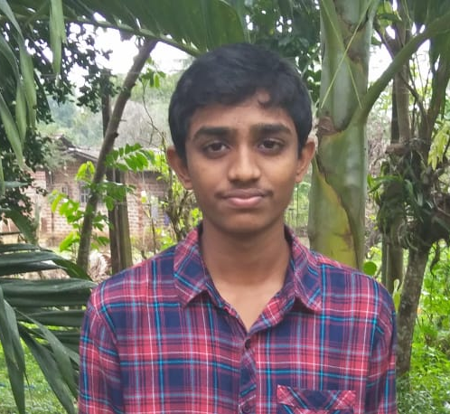
Number
070 273 6237
Jenith Keerthi Oshadha
Nimsara
Shanaka
Minusha
Nilupul

Slide 8
About Our Teacher
Name
NIC
Number
A.N.S.
Gunarathna
838542042V
070 273 6237
Nimsara
Shanaka
Minusha
Nilupul
Thank You

Slide 9
About Our Teacher
Name
NIC
Number
A.N.S.
Gunarathna
838542042V
070 273 6237
Nimsara
Shanaka
Thank You
Minusha
Nilupul

